Slide 1


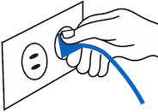

OutLite
Bluetooth Control
Plug & Forget
Monitor Consumption

Slide 2
Turn down for Watt!

